Slide 1

BASICIS OF CIVIL ENGINEERING & MECHANICS
Course code:CV14/CV24
Credits:3:0:0
Topics Covered
Force- Definition, classification of force systems, composition and resolution of forces.
Couple, Moment of Couple

Slide 2

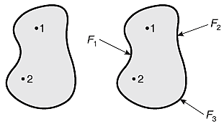
DEPARTMENT OF
CIVIL ENGINEERING
Course: Basics of Civil Engineering & Mechanics
Credits: 3:0:0
Particle: A body of infinitely small volume whose mass can be neglected, is called a particle.
Rigid body: A rigid body is one in which the positions of the constituent particles do not change under the application of external forces, such as the position of particles shown in Figure 1.
Figure. 1 Rigid body
Figure. 2 Deformable body

Slide 3
DEPARTMENT OF
CIVIL ENGINEERING
Course: Basics of Civil Engineering & Mechanics
Credits: 3:0:0
Elements of a Force or Characteristics of a Force
A force can be identified by its four characteristics:
Magnitude: The length of the vector represents the magnitude of force
Direction: The direction of a force can be represented by an arrowhead.
Line of action: It is the line along which the force acts.
Point of application: It is the point at which the force acts.

Slide 4
DEPARTMENT OF
CIVIL ENGINEERING
Course: Basics of Civil Engineering & Mechanics
Credits: 3:0:0
Force system:
If two or more forces are acting on a body or a particle, then it is said to be a force system, such as that shown in Figure 3.
The types of force system are:
1. Coplanar force system
2. Non-coplanar force system
3. Collinear force system.
Figure.3 Force system

Slide 5
DEPARTMENT OF
CIVIL ENGINEERING
Course: Basics of Civil Engineering & Mechanics
Credits: 3:0:0
Coplanar force system
If two or more forces are acting in a single plane, then it is said to be a coplanar force system. The types of coplanar force system are:
Coplanar concurrent force system
(ii) Coplanar non-concurrent force system
(iii) Coplanar parallel force system.

Slide 6
DEPARTMENT OF
CIVIL ENGINEERING
Course: Basics of Civil Engineering & Mechanics
Credits: 3:0:0
(i) Coplanar concurrent force system:
If two or more forces are acting in a single plane and their lines of action pass through a single point, then it is said to be a coplanar concurrent force system. Shown in Figure.4.
Figure.4 Coplanar concurrent force system.

Slide 7
DEPARTMENT OF
CIVIL ENGINEERING
Course: Basics of Civil Engineering & Mechanics
Credits: 3:0:0
(ii) Coplanar non-concurrent force system
If two or more forces are acting in a single plane and their lines of action do not meet at a common point, then the forces constitute a coplanar non-concurrent force system. Shown in Figure.5.
Figure.5 Coplanar non concurrent force system.

Slide 8
DEPARTMENT OF
CIVIL ENGINEERING
Course: Basics of Civil Engineering & Mechanics
Credits: 3:0:0
(iii) Coplanar parallel force system.
If two or more forces are acting in a single plane with their lines of action parallel to one another, then it is said to be a coplanar parallel force system.
The coplanar parallel force system is of two types:
(i) Like parallel force system: All the forces act parallel to one another and are in the same direction, as shown in Figure 6.
Figure.6 Like parallel force system
Figure.7 Unlike parallel force system

Slide 9
DEPARTMENT OF
CIVIL ENGINEERING
Course: Basics of Civil Engineering & Mechanics
Credits: 3:0:0
Non-coplanar force system
If two or more forces are acting in different planes, the forces constitute a non-coplanar force system. Such a system of forces can be,
Non-coplanar concurrent force system
(ii) Non-coplanar non-concurrent force system
(iii) Non-coplanar parallel force system.

Slide 10
DEPARTMENT OF
CIVIL ENGINEERING
Course: Basics of Civil Engineering & Mechanics
Credits: 3:0:0
Non-coplanar concurrent force system
If a system has two or more forces acting on different planes but pass through the same point, then it is said to be a non-coplanar concurrent force system. As shown Figure.8.
Figure.8 Non-coplanar concurrent force system

Slide 11
DEPARTMENT OF
CIVIL ENGINEERING
Course: Basics of Civil Engineering & Mechanics
Credits: 3:0:0
(ii) Non-coplanar non-concurrent force system
If two or more forces are acting on different planes but do not pass through the same point, they constitute a non-coplanar non-concurrent force system. As shown in Figure 9.
Figure.9 Non-coplanar non-concurrent force system

Slide 12
DEPARTMENT OF
CIVIL ENGINEERING
Course: Basics of Civil Engineering & Mechanics
Credits: 3:0:0
(iii) Non-coplanar parallel force system.
If two or more forces are acting in different planes and are parallel to one another, the system is said to be a non-coplanar parallel force system. As shown in Figure 10.
Figure.10 Non-coplanar parallel force system

Slide 13
DEPARTMENT OF
CIVIL ENGINEERING
Course: Basics of Civil Engineering & Mechanics
Credits: 3:0:0
Collinear force system
If the lines of action of two or more forces coincide with one another, it is called a collinear force system as shown in Figure.11.
Figure.11 Collinear force system.
Non-collinear force system
If the lines of action of the forces do not coincide with one another, it is called a non-collinear force system as shown in Figure.12.
Figure.12 Non-collinear force system.

Slide 14
DEPARTMENT OF
CIVIL ENGINEERING
Course: Basics of Civil Engineering & Mechanics
Credits: 3:0:0
Principle of Transmissibility of Forces
This principle states that a force can be transmitted from one point to another point along the same line of action such that the effect produced by the force on a body remains unchanged.
Figure.13 Transmissibility of force F from point O to O’.

Slide 15
DEPARTMENT OF
CIVIL ENGINEERING
Course: Basics of Civil Engineering & Mechanics
Credits: 3:0:0
Resolution of a Force
The process of splitting of a force into its two rectangular components (horizontal and vertical) is known as resolution of the force, as shown in Figure.14.
In this figure, F is the force which
makes an angle ɵ with the horizontal axis, and has been resolved into two components, namely Fx and Fy, along the x-axis and y-axis respectively.
Figure.14 Resolution of a force.

Slide 16
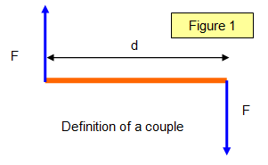
DEPARTMENT OF
CIVIL ENGINEERING
Course: Basics of Civil Engineering & Mechanics
Credits: 3:0:0
Couple
A couple consists of two parallel forces that are equal in magnitude, opposite in sense and do not share a line of action. It does not produce any translation, only rotation. The resultant force of a couple is zero. but, the resultant of a couple is not zero; it is a pure moment.

Slide 17
DEPARTMENT OF
CIVIL ENGINEERING
Course: Basics of Civil Engineering & Mechanics
Credits: 3:0:0
Moment of a couple
The tendency of a force is to rotate a body. It is measured by the moment of the force. The product of one of the two forces of a Couple and the perpendicular distance between their lines of action (called the arm of the Couple) is called the Moment of Couple.

Slide 18
DEPARTMENT OF
CIVIL ENGINEERING
Course: Basics of Civil Engineering & Mechanics
Credits: 3:0:0
Characteristics of couple
The algebraic sum of the forces consisting the couple is zero
The algebraic sum of the moment of the forces constituting the couple about any point is the same and equal to the moment of the couple itself.
A couple cannot be balanced by a single force but can be balanced only by a couple but of opposite sense.
Any number of coplanar couples can be reduced to a single couple whose magnitude will be equal to the algebraic sum of the moments of all the couples.

Slide 19
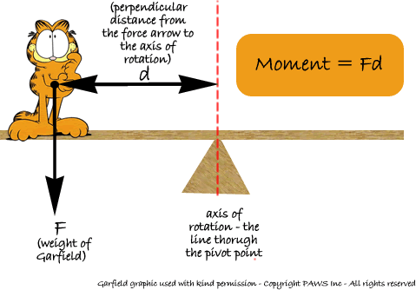
Moment of Force
DEPARTMENT OF
CIVIL ENGINEERING
Course: Basics of Civil Engineering & Mechanics
Credits: 3:0:0
The turning effect of a force (torque) is known as the moment.
It is the product of the force multiplied by the perpendicular distance from the line of action of the force to the pivot or point where the object will turn.

Slide 20
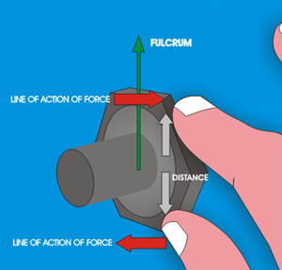
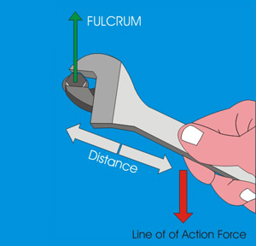
Moment of Force
DEPARTMENT OF
CIVIL ENGINEERING
Course: Basics of Civil Engineering & Mechanics
Credits: 3:0:0
SMALL MOMENT The distance from the fulcrum to the line of action of force is very small
LARGE MOMENT The distance from the fulcrum to the line of action of force is large

Slide 21
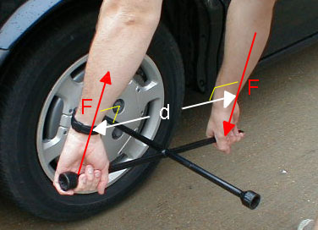
Moment of Force
DEPARTMENT OF
CIVIL ENGINEERING
Course: Basics of Civil Engineering & Mechanics
Credits: 3:0:0
Moments taken are about a point are indicate as being clockwise or counterclockwise
For the sake of uniformity in calculation, assume clockwise to be +ve and counterclockwise to be -ve.
Moment can expressed as Nm or kNm

Slide 22
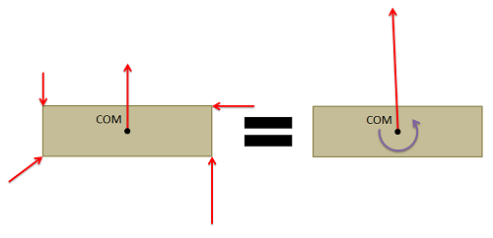
DEPARTMENT OF
CIVIL ENGINEERING
Course: Basics of Civil Engineering & Mechanics
Credits: 3:0:0
Equivalent force couple system
Every set of forces and moments has an equivalent force couple system. This is a single force and pure moment (couple) acting at a single point that is statically equivalent to the original set of forces and moments

Slide 23
COUPLE
DEPARTMENT OF
CIVIL ENGINEERING
Course: Basics of Civil Engineering & Mechanics
Credits: 3:0:0
These force could have been treated as a couple, which consists of two forces that are:
Equal
Acting in opposite direction
Separated by some perpendicular distance d
These three requirement of couple, from the example, we have;
Couple moment = (F) (d)
= -5 (20)
= -100 kNm

Slide 24
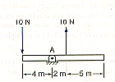
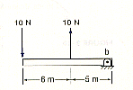
COUPLE EXAMPLE
DEPARTMENT OF
CIVIL ENGINEERING
Course: Basics of Civil Engineering & Mechanics
Credits: 3:0:0
M_{A}=-(10N)(4m)-(10N)(2m)
=-40-20
=-60 N.m
=60N.m
M_{b}=-(10N)(11m)(10N)(5m)
= -110+50
= -60 N.m
= 60N.m

Slide 25
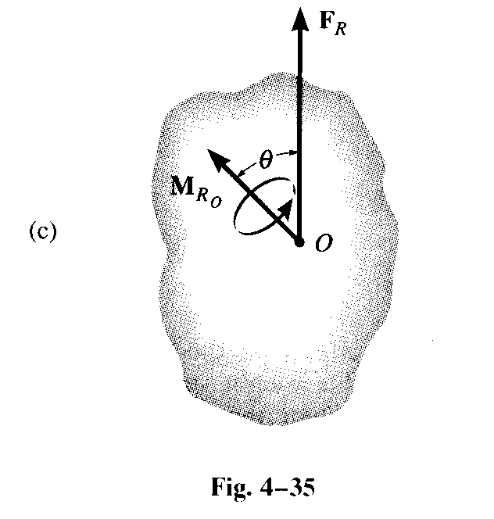
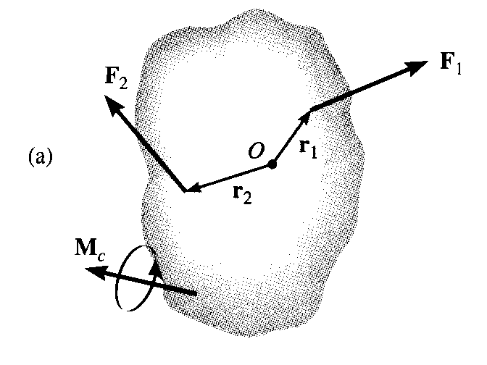
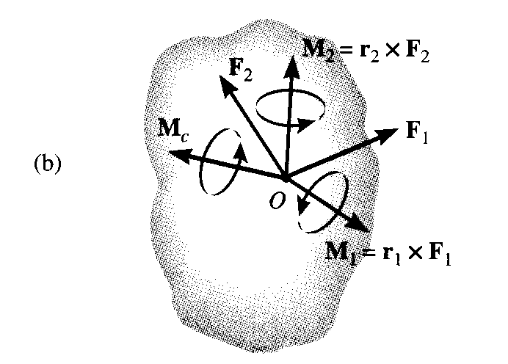
Resultant A force and couple system
DEPARTMENT OF
CIVIL ENGINEERING
Course: Basics of Civil Engineering & Mechanics
Credits: 3:0:0
When a rigid body is subjected to a system of forces and couple moments
The external effects on the body by replacing the system by an equivalent single resultant force acting at a specified point O and a resultant couple moment
Point O is not on the line of action of the forces, an equivalent effect is produced if the forces are moved to point O and the corresponding couple moments M₁=r₁xF₁ and M₂=r₂xF₂ are applied to body

Slide 26
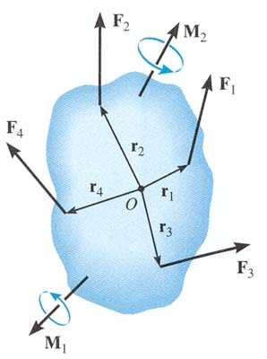
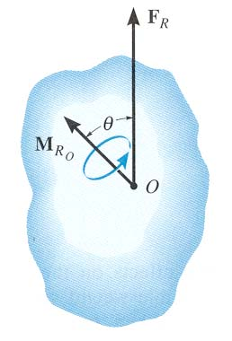
DEPARTMENT OF
CIVIL ENGINEERING
Course: Basics of Civil Engineering & Mechanics
Credits: 3:0:0
AN EQUIVALENT SYSTEM
=
When a number of forces and couple moments are acting on a body, it is easier to understand their overall effect on the body if they are combined into a single force and couple moment having the same external effect
The two force and couple systems are called equivalent systems since they have the same external effect on the body.

Slide 27
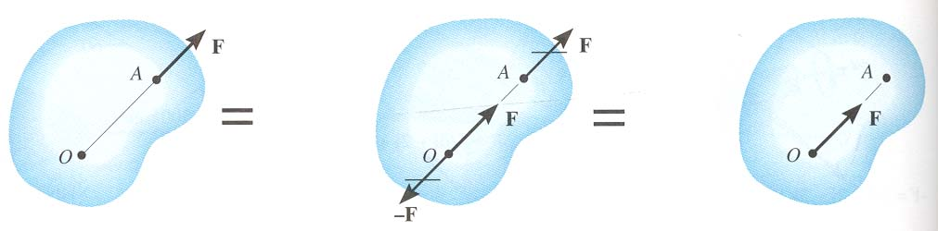
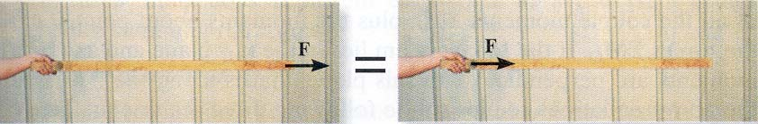
DEPARTMENT OF
CIVIL ENGINEERING
Course: Basics of Civil Engineering & Mechanics
Credits: 3:0:0
MOVING A FORCE ON ITS LINE OF ACTION
Moving a force from A to O, when both points are on the vectors’ line of action, does not change the external effect. Hence, a force vector is called a sliding vector. (But the internal effect of the force on the body does depend on where the force is applied).

Slide 28
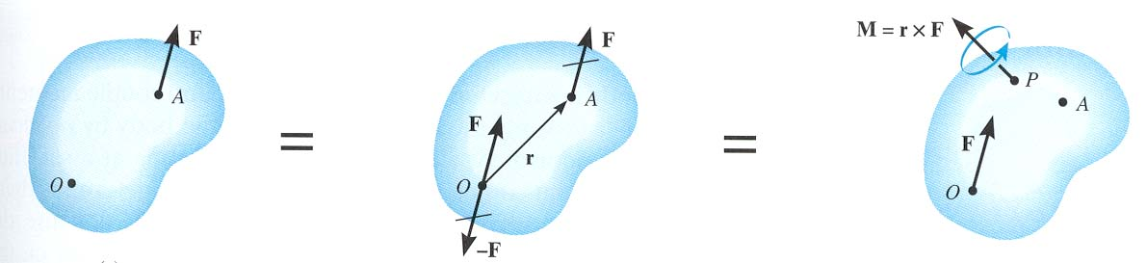
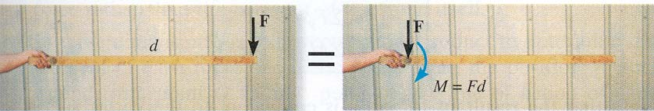
DEPARTMENT OF
CIVIL ENGINEERING
Course: Basics of Civil Engineering & Mechanics
Credits: 3:0:0
MOVING A FORCE OFF OF ITS LINE OF ACTION
Moving a force from point A to O (as shown above) requires creating an additional couple moment. Since this new couple moment is a “free” vector, it can be applied at any point P on the body.

